Slide 1
L
evel
With
Me
The Isolated Ducks

Slide 2





The Team
Ignacio
Di Paola
Alexander
Gerhards
Lars
Kalthoff
Alexandru
Negoescu
Robert
Pavic

Slide 3
Alexander
Gerhards
The Team
Ignacio
Di Paola
Lars
Kalthoff
Alexandru
Negoescu
Robert
Pavic

Slide 4

The Concept
First-person shooter

Slide 5


The Concept
First-person shooter
Fictional
developer studio

Slide 6


The Concept
First-person shooter
Fictional
developer studio
Same level, different iterations

Slide 7

The Concept
First-person shooter
Fictional
developer studio
Same level, different iterations

Slide 8
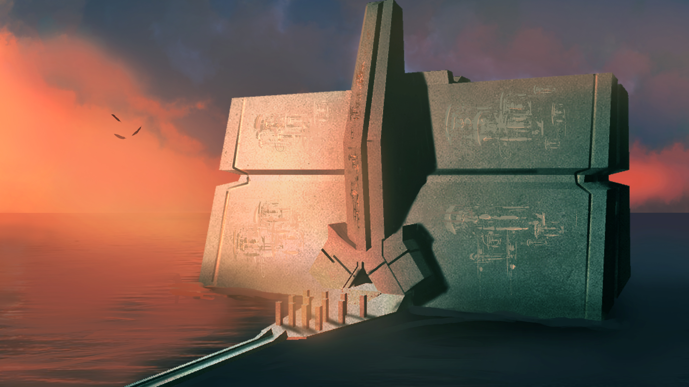

Slide 9
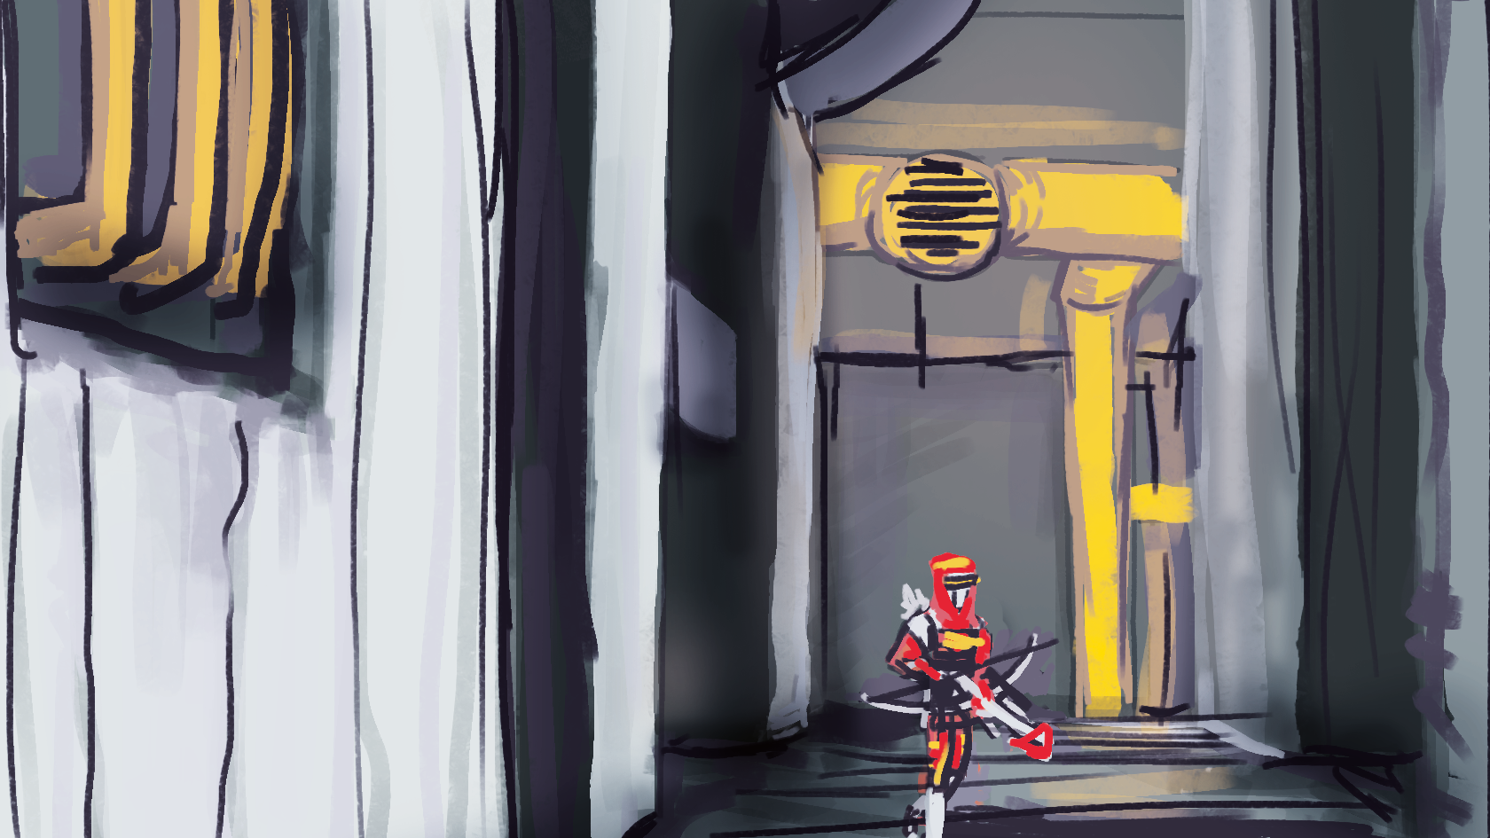

Slide 10
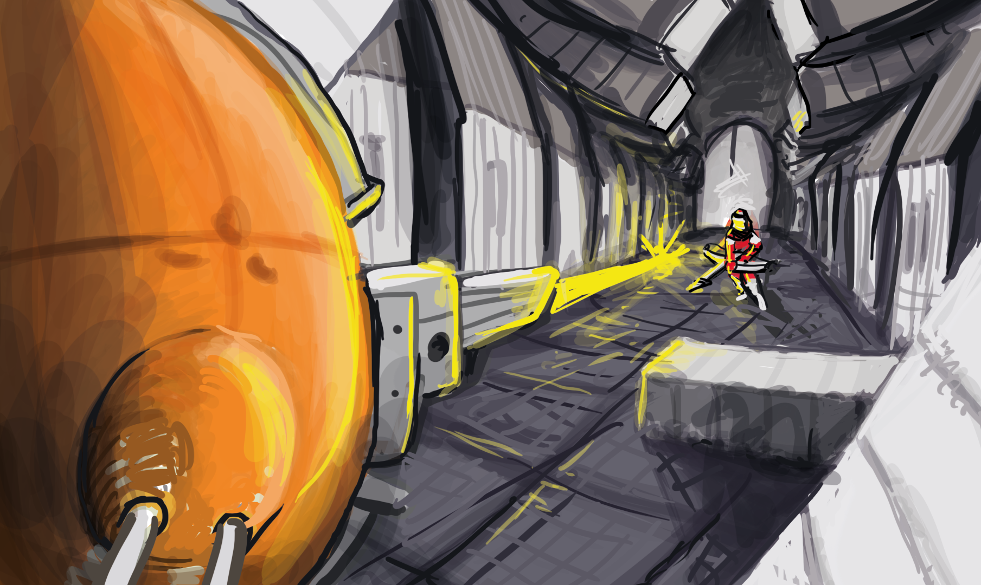

Slide 11
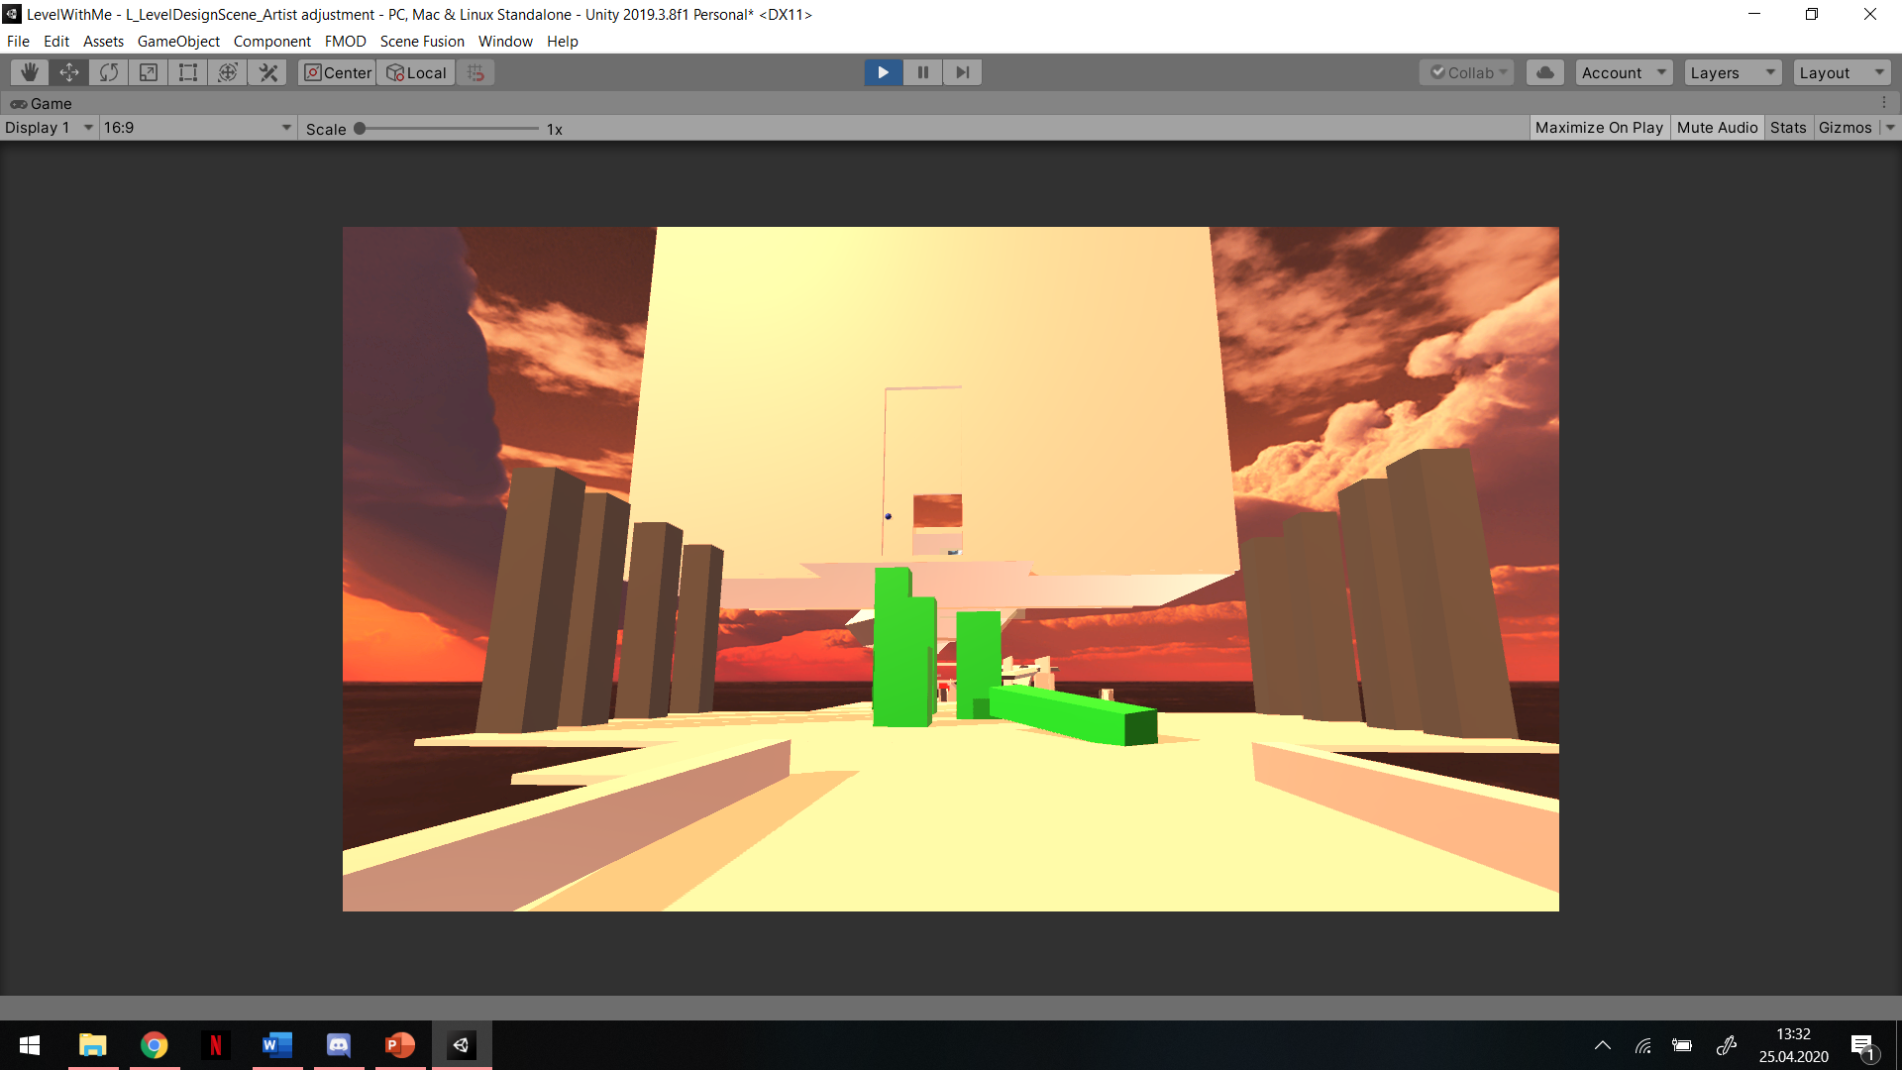
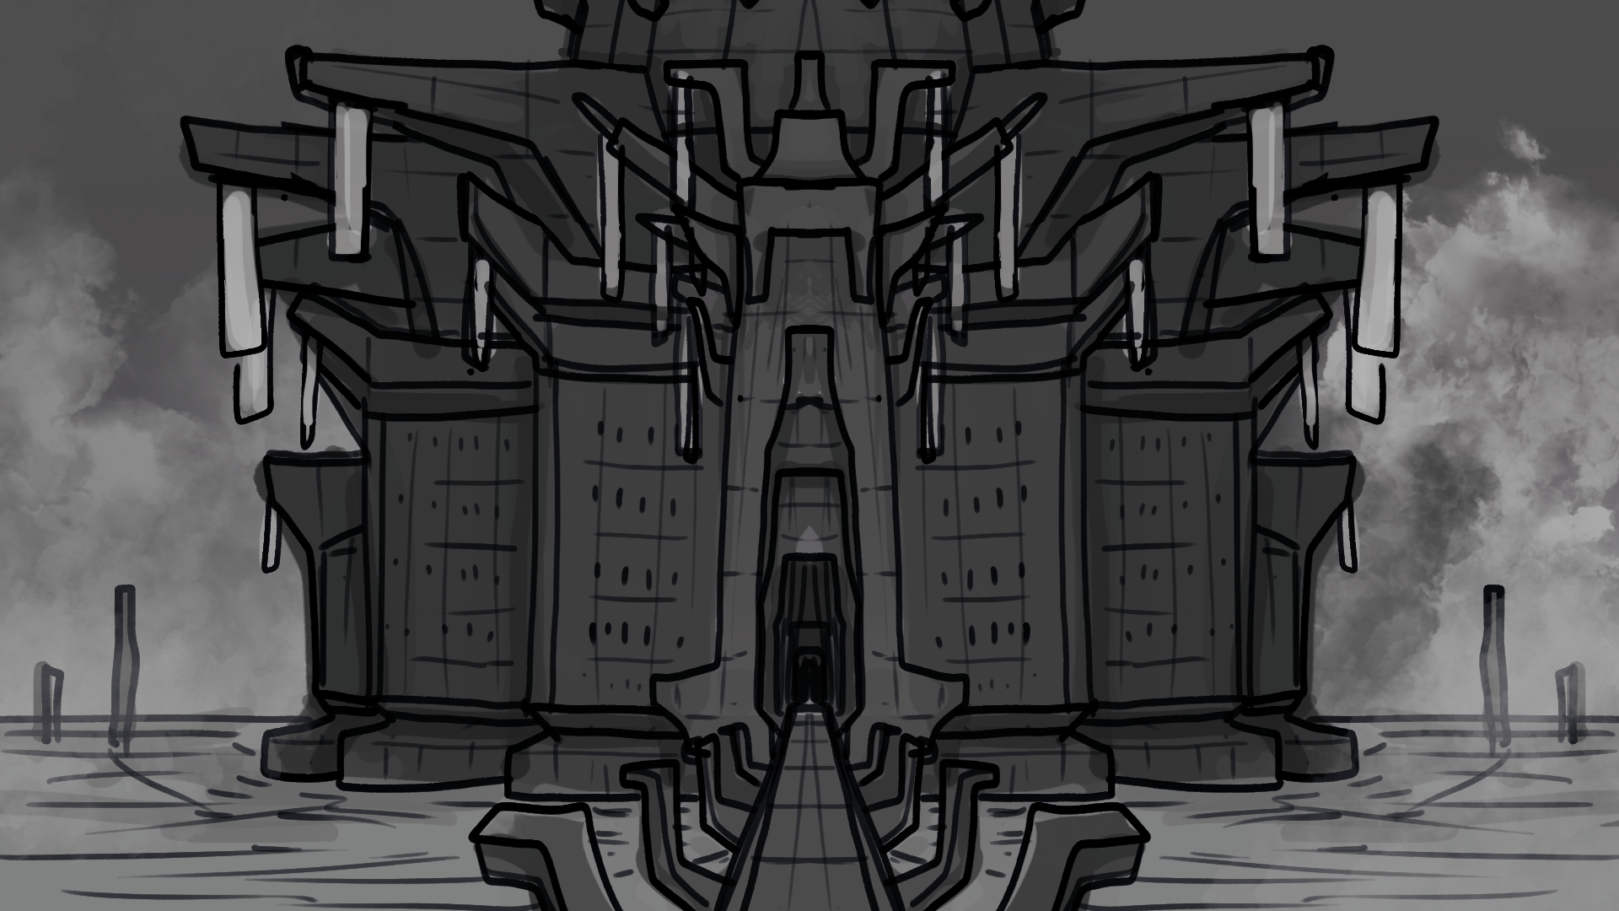
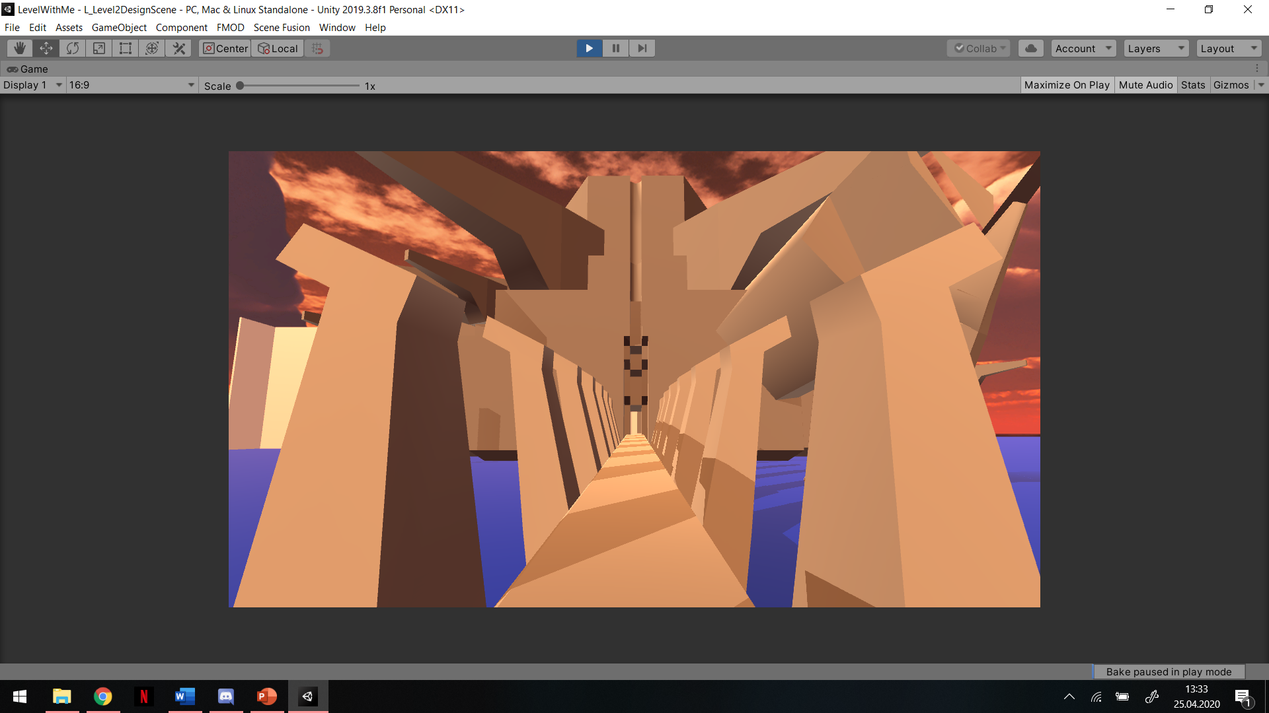
Development Stages
First
prototype
Vertical
slice
Playable
level

Slide 12
Development Stages
CUT
CUT
First
prototype
Vertical
slice
Playable
level

Slide 13
Transformation

Slide 14

Transformation

Slide 15

Transformation

Slide 16

Transformation

Slide 17

Transformation

Slide 18

Transformation

Slide 19
Transformation

Slide 20

Transformation
Incremental

Slide 21


Transformation
Radical
Incremental

Slide 22
Storytelling

Slide 23

Storytelling
Notes placed by developers

Slide 24

Storytelling
Notes placed by developers
Positioned close to their subject

Slide 25

Storytelling
Notes placed by developers
Positioned close to their subject
Critical information, nice to know, fluff

Slide 26
Team Bonsai

Slide 27





Team Bonsai
Bonnie
The Lone Wolf
Alejandro
The Gambler
Iver
The Player
Nikolai
The Dreamer
Sandra
The Veteran

Slide 28
Target Audience

Slide 29

Target Audience
Dedicated players
Core gamers, journalists

Slide 30

Target Audience
Dedicated players
Core gamers, journalists
Aspiring developers
Students, hobbyists, newcomers

Slide 31

Target Audience
Dedicated players
Core gamers, journalists
Aspiring developers
Students, hobbyists, newcomers
Other creatives
Writers, filmmakers, architects, …

Slide 32


Player Types
Creativity
“What If?”
Immersion
“Once Upon a Time”
Design
Fantasy
Discovery
Story

Slide 33
Player Types
Creativity
“What If?”
Immersion
“Once Upon a Time”
Design
Fantasy
Discovery
Story

Slide 34
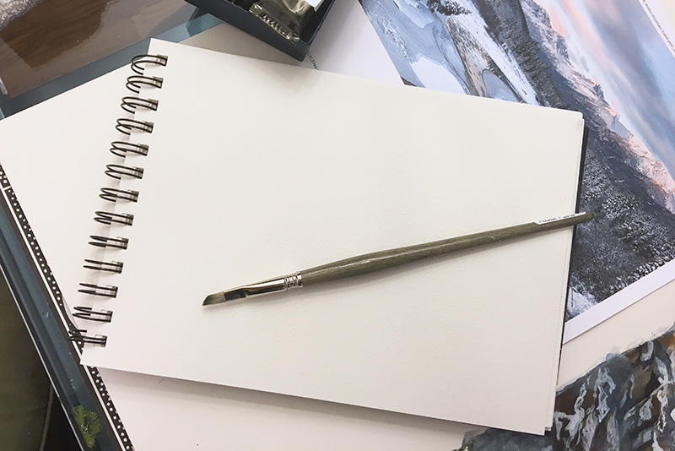
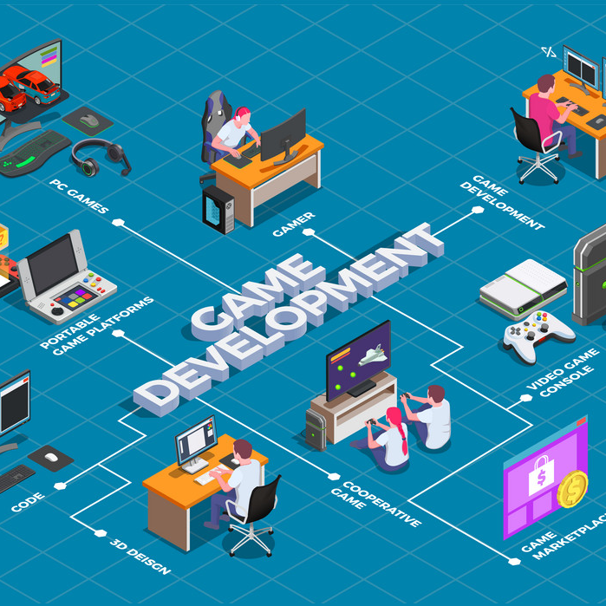

Media Trends
2
1
3
Integration of unfinished work
Meta-commentary on media production
Focus on creators, not just product

Slide 35


Slide 36
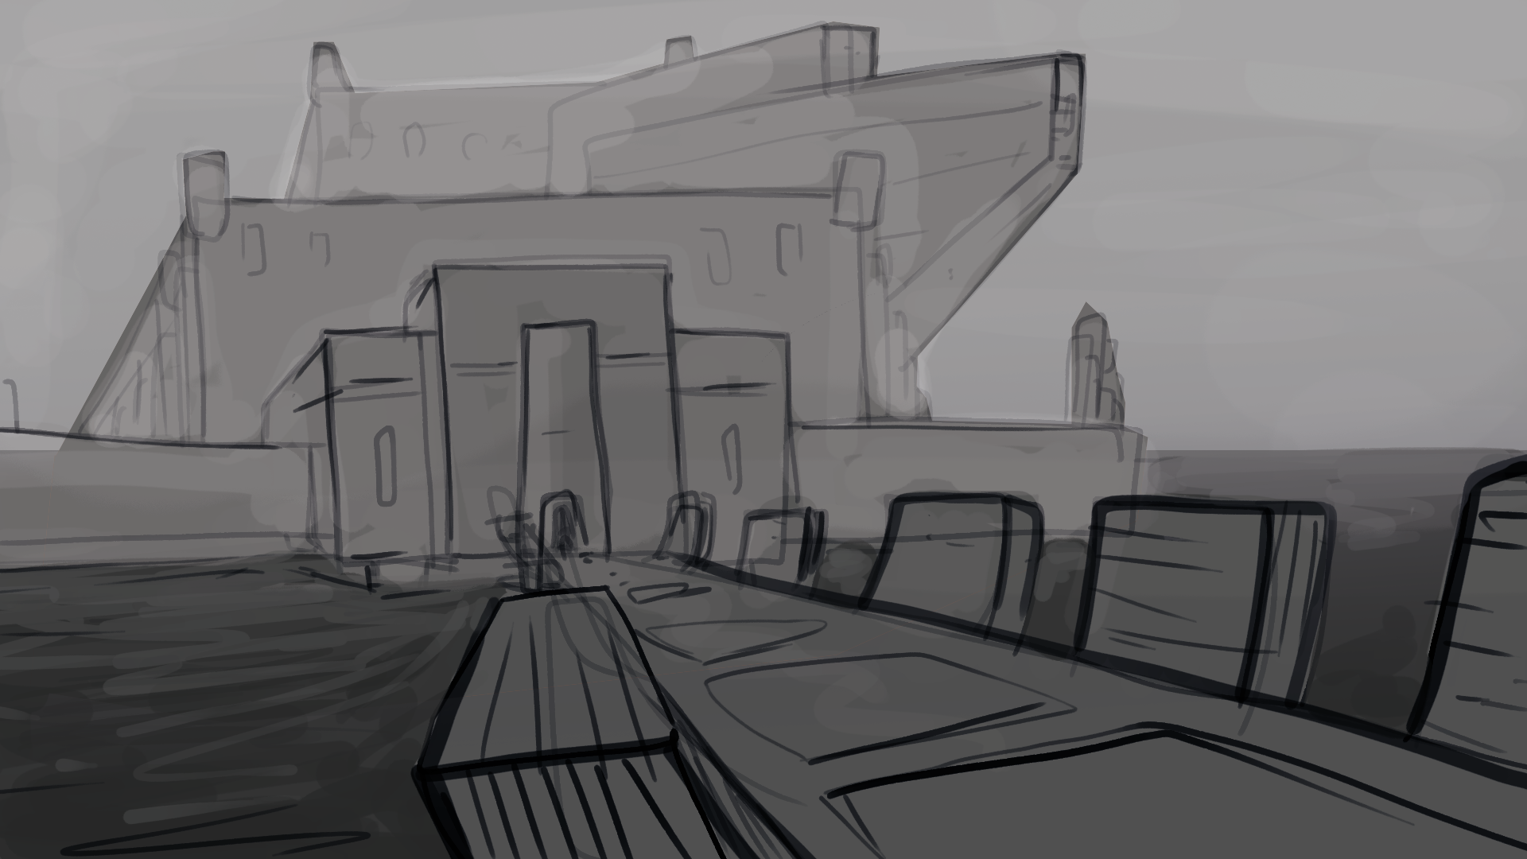
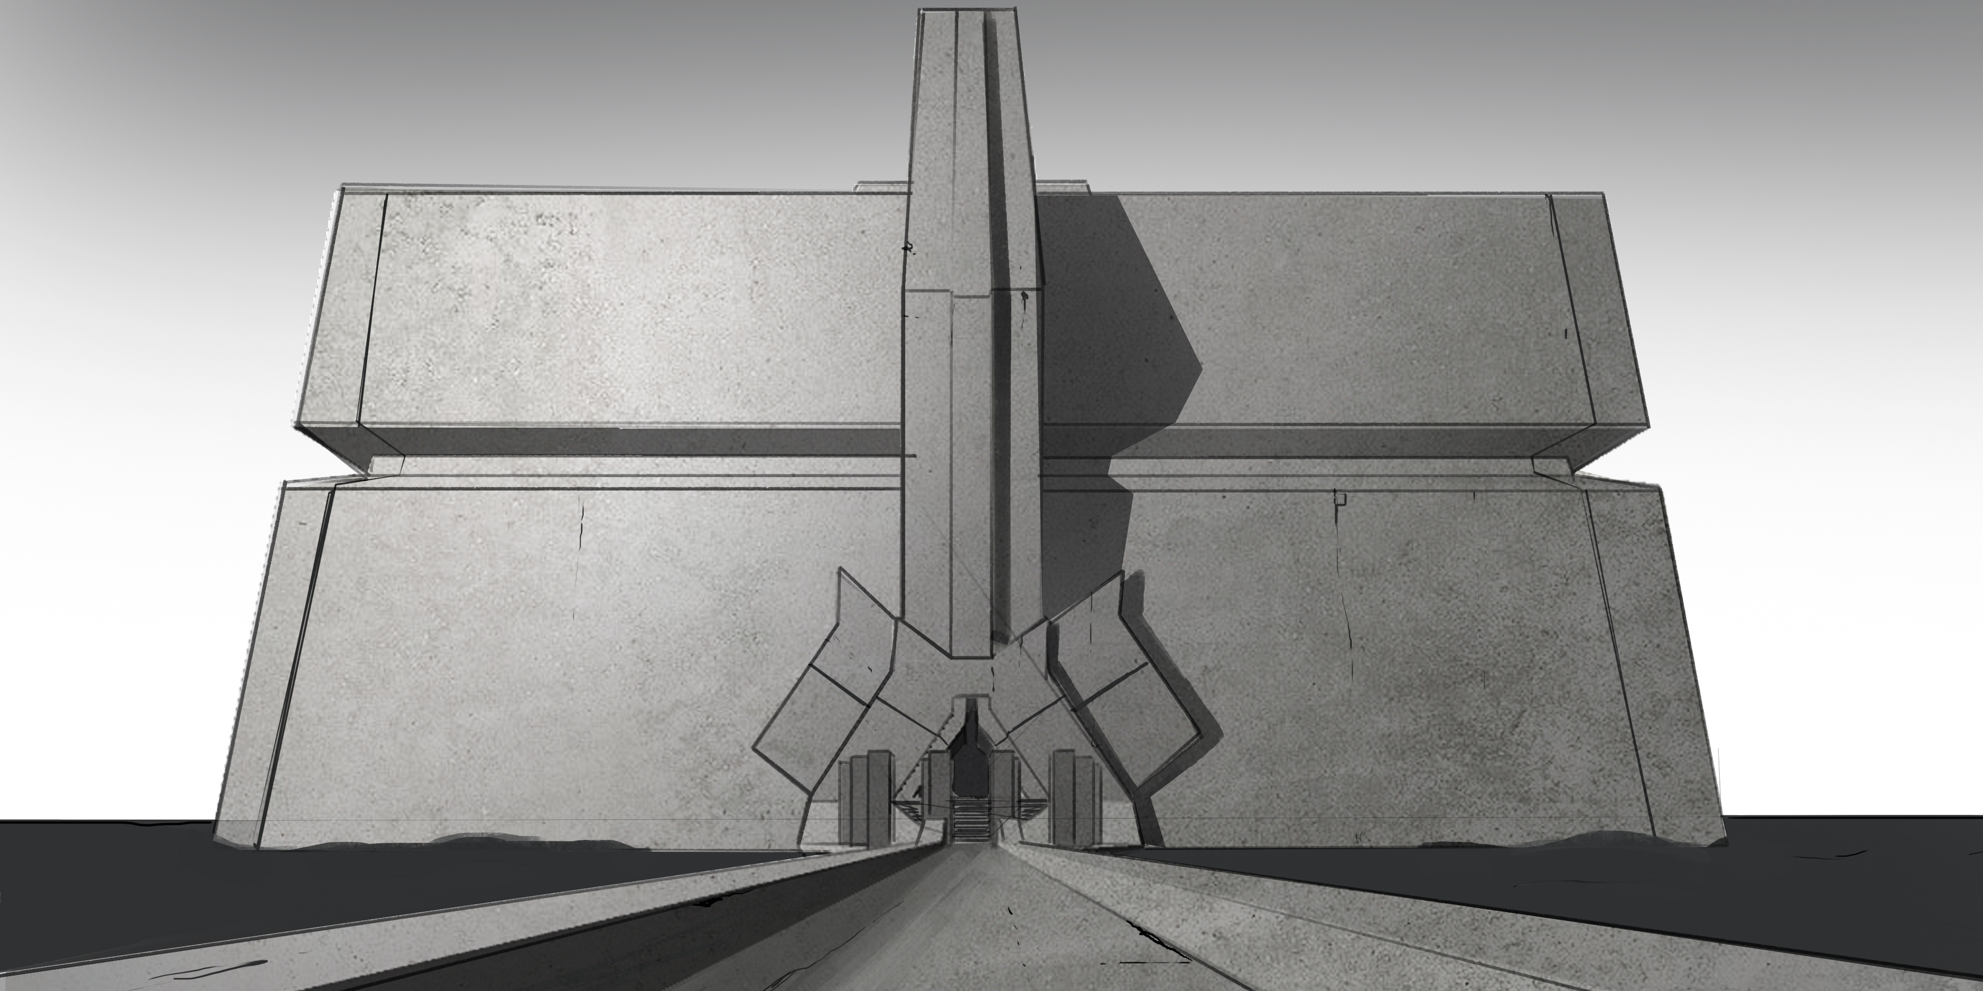
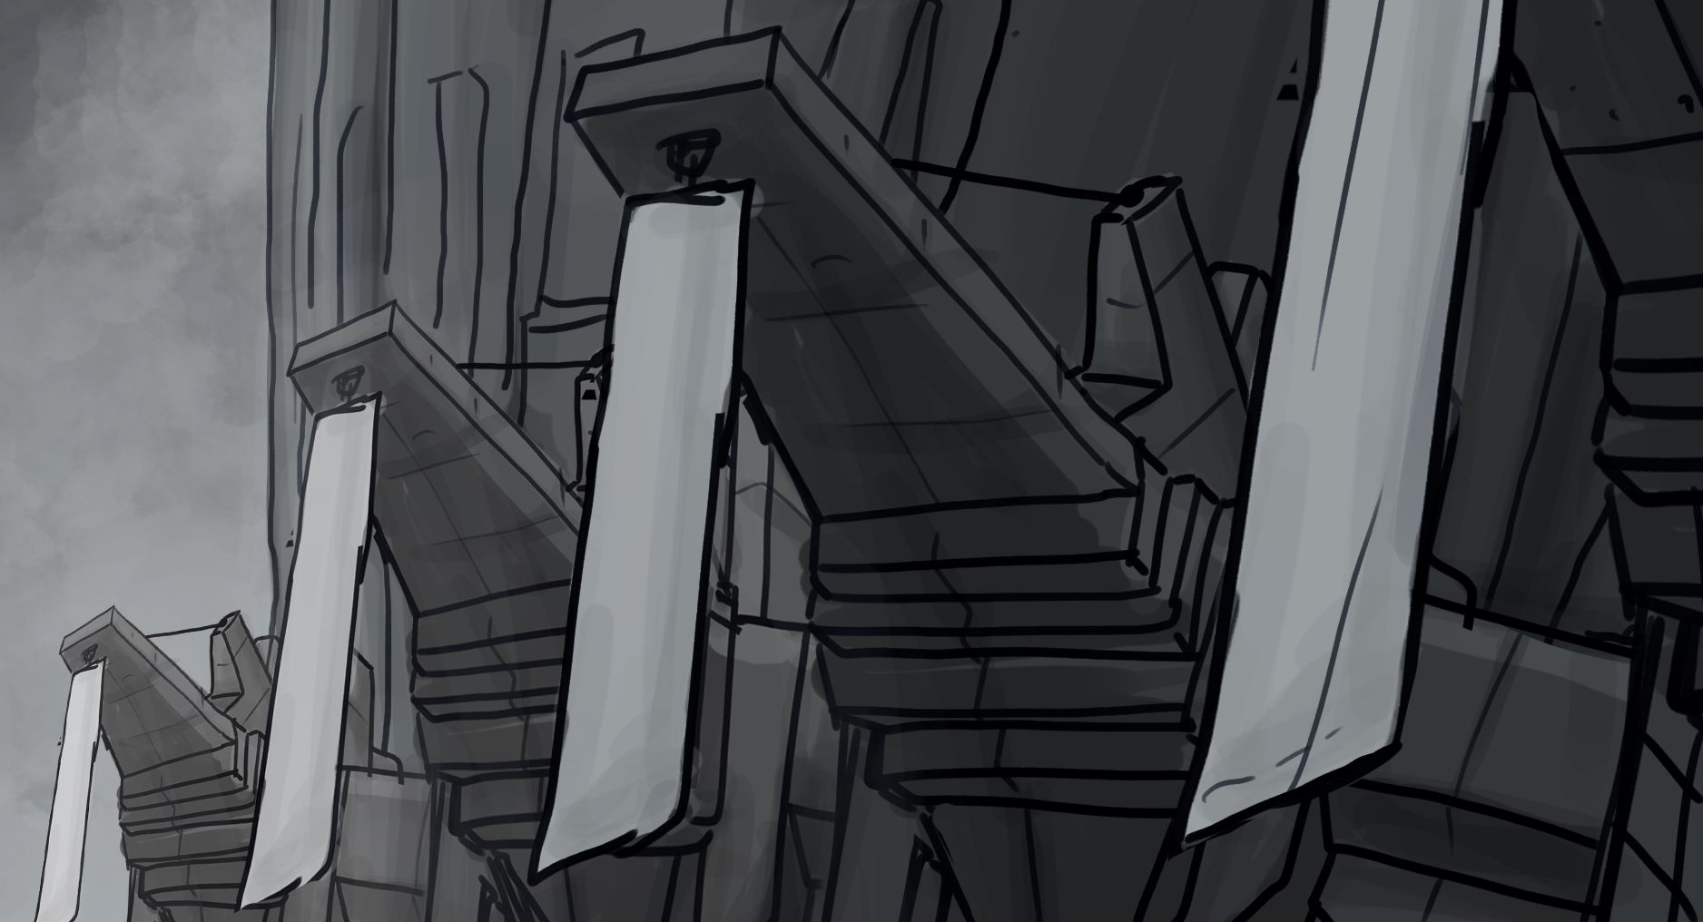

Slide 37
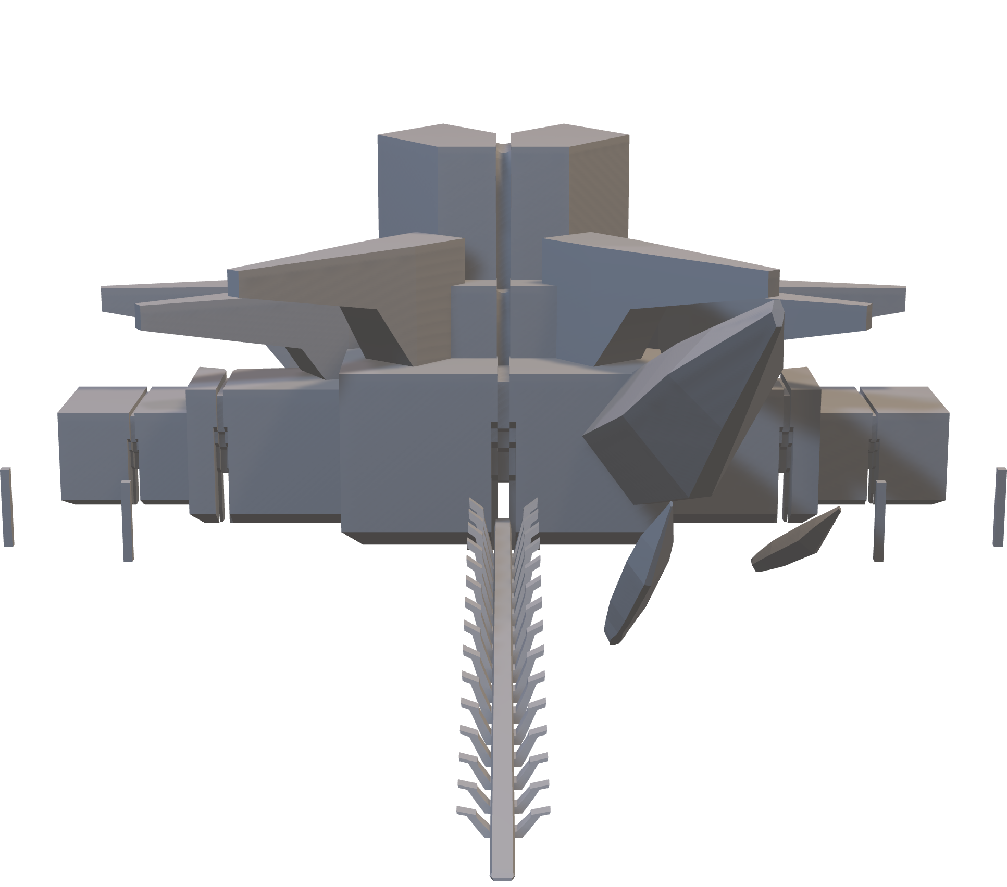

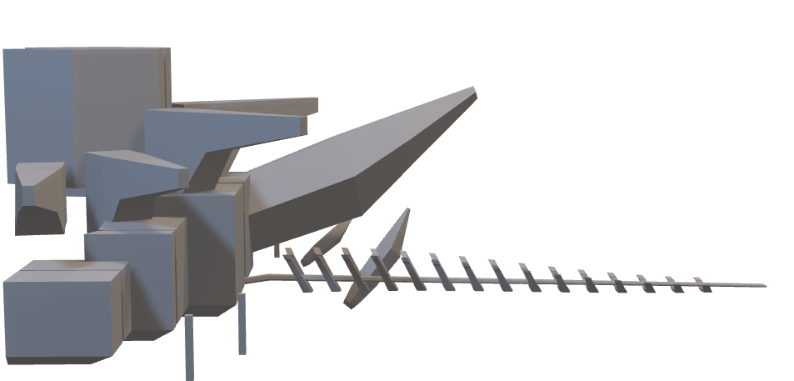

Slide 38
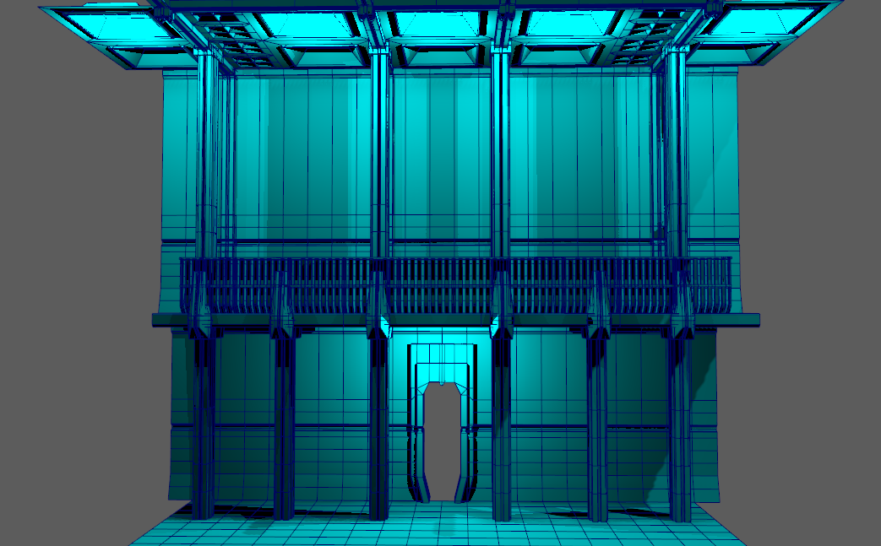
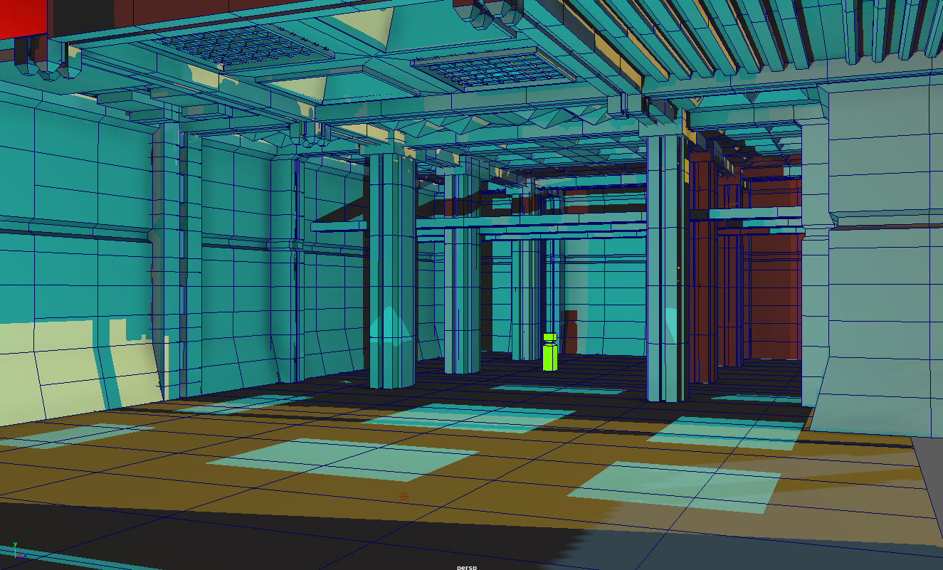
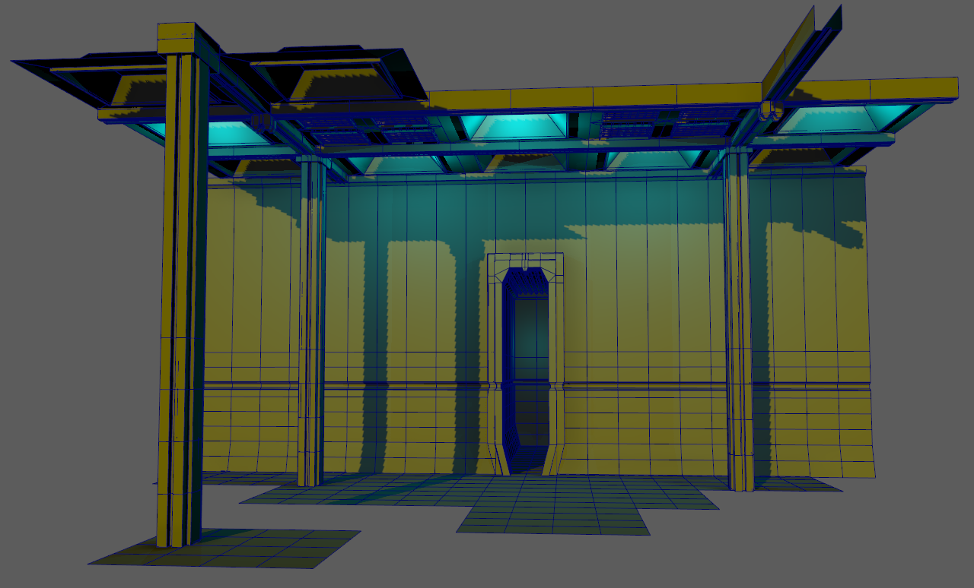
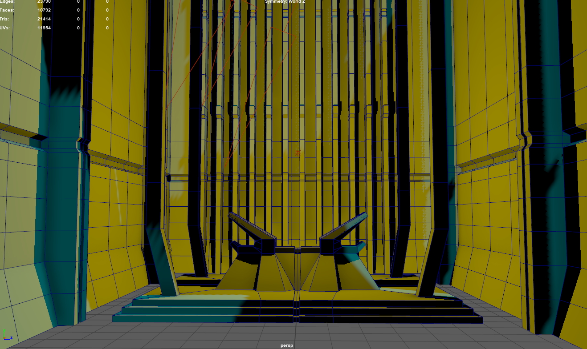

Slide 39
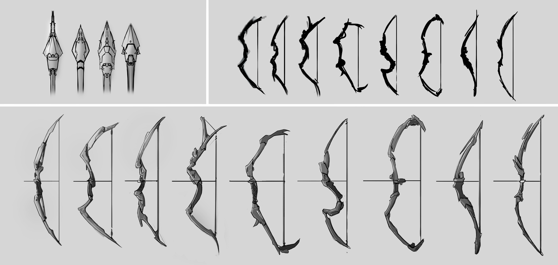
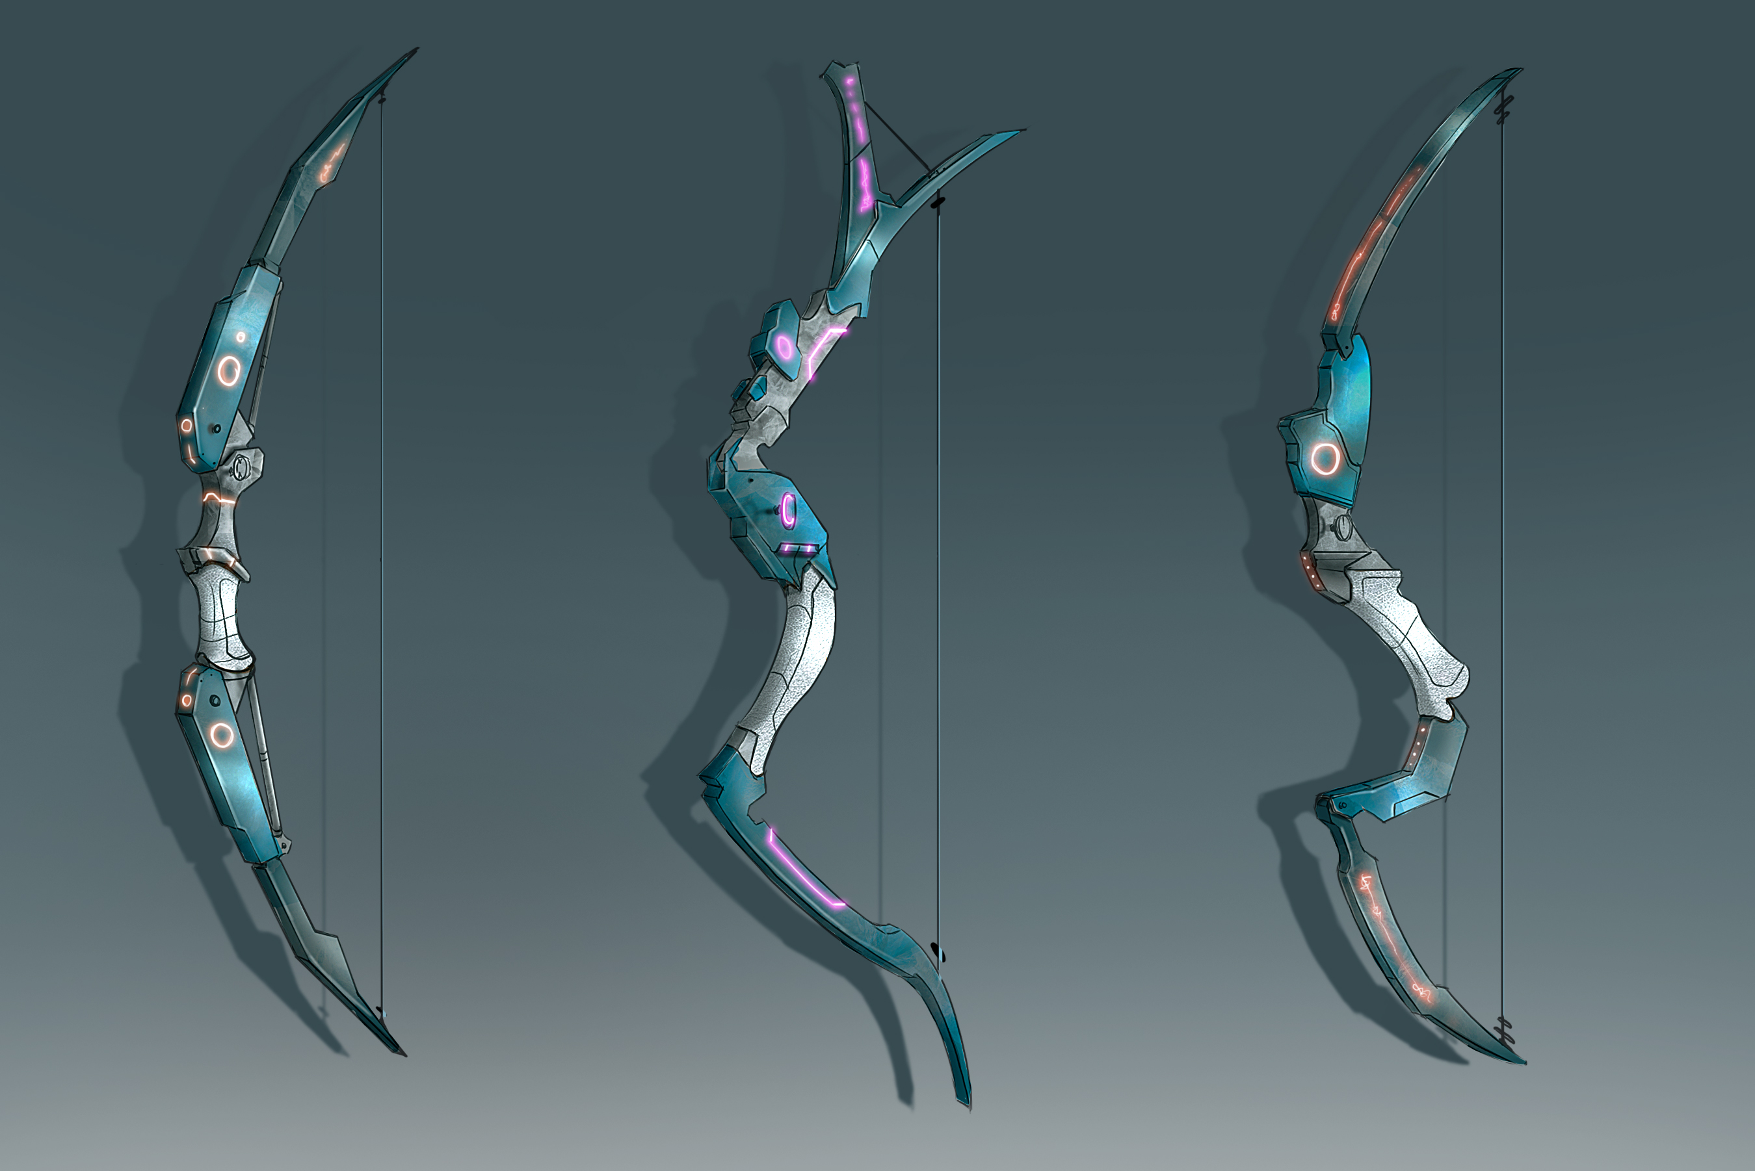
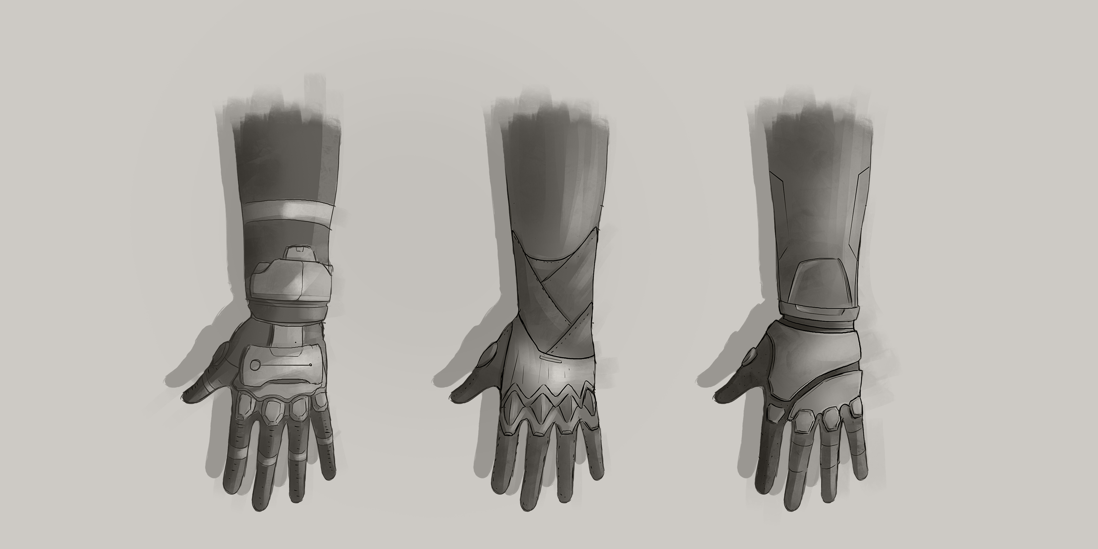
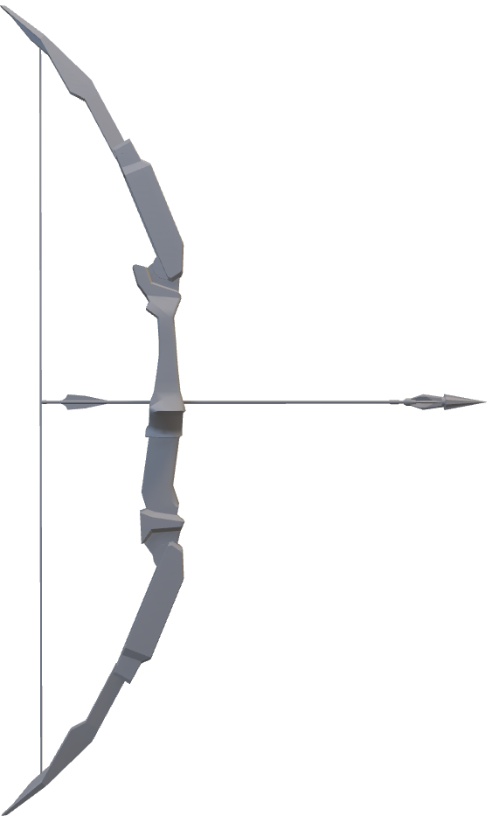

Slide 40
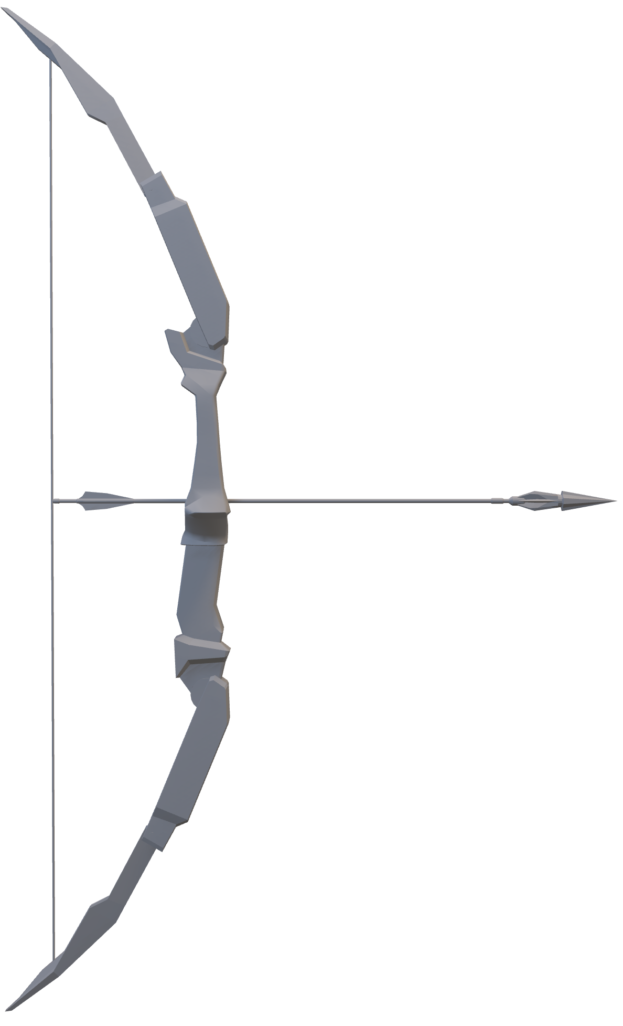

Slide 41
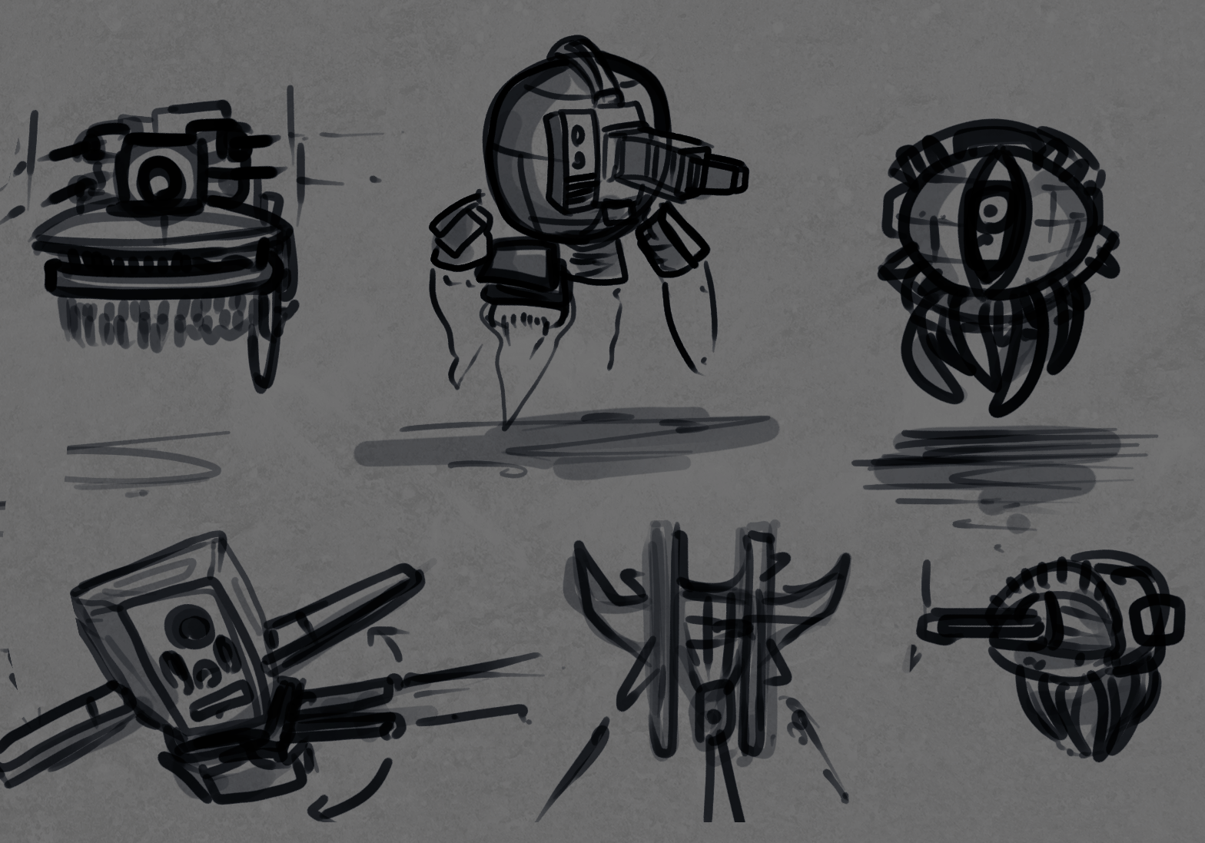

Slide 42
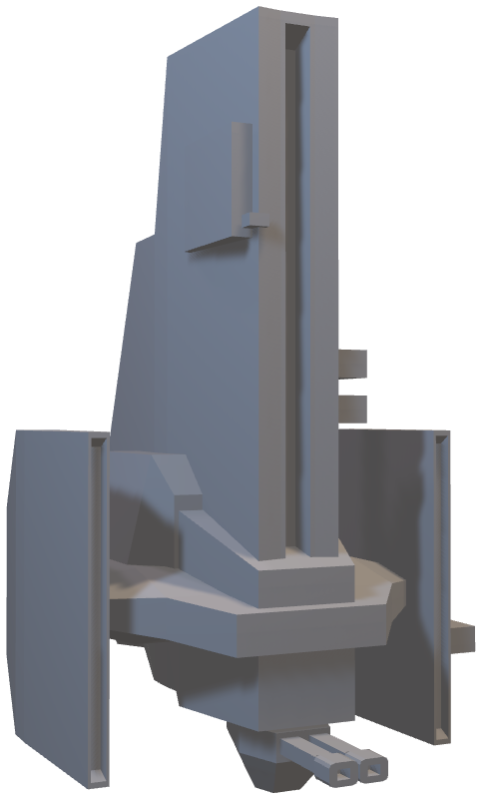

Slide 43
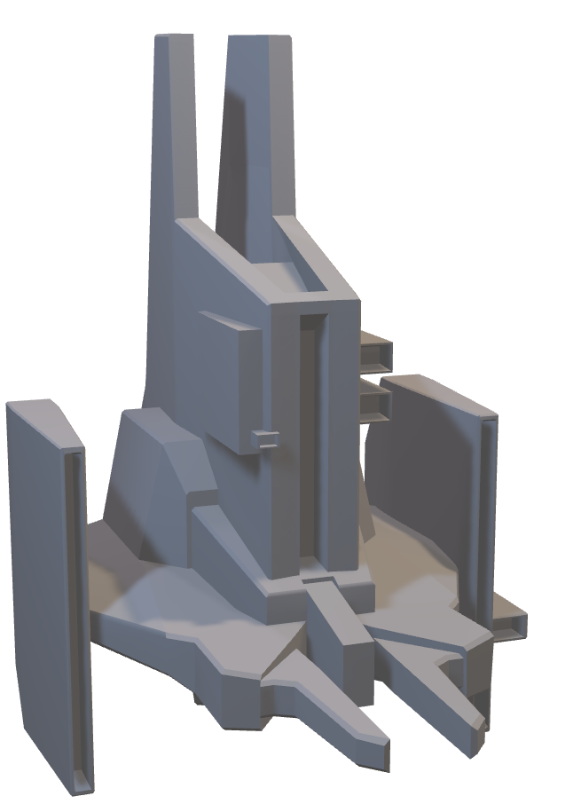
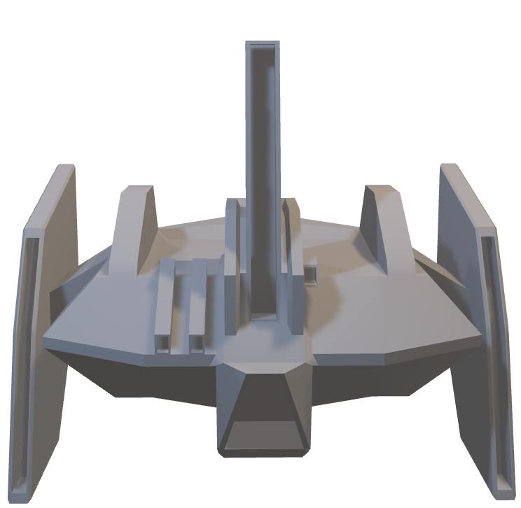

Slide 44
Sound Design

Slide 45

Sound Design
Absence of sound as part of narrative

Slide 46

Sound Design
Absence of sound as part of narrative
Free libraries for effects

Slide 47

Sound Design
Absence of sound as part of narrative
Free libraries for effects
Compose and record music

Slide 48
Technical Outline

Slide 49

Technical Outline
Unity version 2019.3.8f1

Slide 50

Technical Outline
Unity version 2019.3.8f1
Snapshots of early scripts (except DevNotes)

Slide 51

Technical Outline
Unity version 2019.3.8f1
Snapshots of early scripts (except DevNotes)
Bugs are part of the game

Slide 52

GAMEPLAY
VIDEO

Slide 53
INSERT GAMEPLAY VIDEO (1 min)

Slide 54


Project Management
Two project managers,
alternating roles

Slide 55



Project Management
Two project managers,
alternating roles
Agile development,
weekly sprints

Slide 56


Project Management
Two project managers,
alternating roles
Agile development,
weekly sprints
QA testing with and for another team

Slide 57
Project Management
Two project managers,
alternating roles
Agile development,
weekly sprints
QA testing with and for another team

Slide 58
Project Plan
April
MONDAY | TUESDAY | WEDNESDAY | THURSDAY | FRIDAY | SATURDAY | SUNDAY
 |  | 1 | 2 | 3 | 4 | 5
6 | 7 | 8 | 9 | 10 | 11 | 12
13 | 14 | 15 | 16 | 17 | 18 | 19
20 | 21 | 22 | 23 | 24 | 25 | 26
27 | 28 | 29 | 30
We are here
Stage 1
Stage 2
Stage 3

Slide 59
Project Plan
May
MONDAY | TUESDAY | WEDNESDAY | THURSDAY | FRIDAY | SATURDAY | SUNDAY
 |  |  |  | 1 | 2 | 3
4 | 5 | 6 | 7 | 8 | 9 | 10
11 | 12 | 13 | 14 | 15 | 16 | 17
18 | 19 | 20 | 21 | 22 | 23 | 24
25 | 26 | 27 | 28 | 29 | 30 | 31
Stage 3
Polish

Slide 60
Thank
You!
The Isolated Ducks

Slide 61

The
Isolated
Ducks

Slide 62
Intermediate Presentation
L
evel
With
Me

